Slide 1


SDS National Survey
Scottish Disability Sport
Queen Margaret University
National Survey 2025
Notes:
As you’ve heard this is our first ever National Survey and was carried out in partnership with the Queen Margaret University Centre for Health, Activity and Rehabilitation Research

Slide 2
SDS National Survey
Purpose
To amplify the voices of people with a disability in Scotland and adopt an evidence-based approach to local and national strategic development and policy engagement in a physical activity and sport context
Notes:
All too often, available evidence is UK or English-centric and whilst broadly applicable, it was felt that to be a credible, evidence-based, participant-centred organisation we needed to find out what those with lived-experience think,

Slide 3






Existing Evidence
24% of people in Scotland have a disability
There are 627,700
unpaid carers in Scotland
Scottish Census, 2022​
Scottish Census, 2022​
“it would be logical for the benefit system to encourage rather than discourage participation in health-enhancing exercise.”
An estimated 3,185 deaths and over 11,000 disability-adjusted life are attributable to physical inactivity in Scotland.
Observatory for Sport & University of
West of Scotland Research 2021​
Public Health Scotland, 2024​
www.scottishdisabilitysport.com
Notes:
Here’s what we know already. There is still a lot of evidence out there and it is so important we build on what is already there and continue to collaborate and utilise our partners’ data to illustrate the challenges and find the way forward.

Slide 4



Existing Evidence
43% of disabled people said it costs a lot of money to run their independent living equipment that they need to survive.
45% of families are experiencing income insufficiency, meaning they cannot meet day-to-day expenses despite receiving disability benefits.
Disability Equality Scotland,
Cost of Living Survey 2024​
The Family Fund - The Cost of Caring, 2025​
People living with disability are at least twice as likely to be physically inactive as those without disability, increasing the risk of disease, poor mental health and social well-being.
On average, disabled households need an additional £1,010 a month to have the same standard of living as non-disabled households.
Scope, 2024​
The First Global Physical Activity and Sedentary Behavior Guidelines for People Living With Disability, Carty et al, 2021
www.scottishdisabilitysport.com

Slide 5
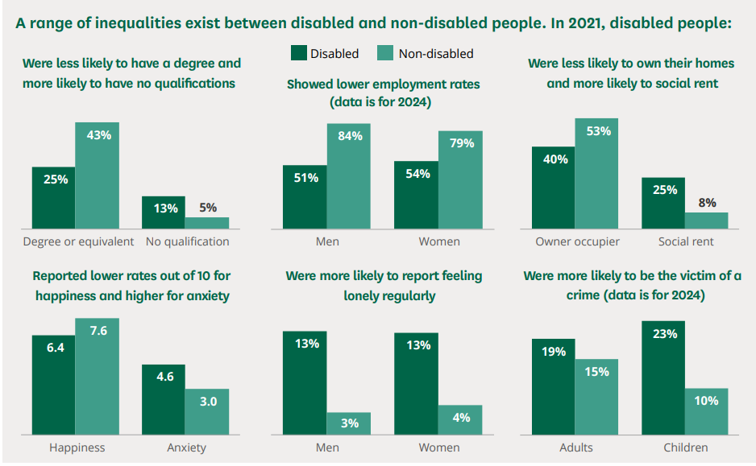

UK Disability Statistics: Prevalence and life experiences

Slide 6

Introduction & Context
335 Responses
Partnership with QMU
Focus Groups
59% Female
36% Male
1% Non-Binary
Initial project undertaken on gathering results
Need for Scottish evidence and lived experience

Slide 7
Spina Bifida
Misc MSK
Cardiovascular
Spinal Cord injury/ Paraplegia

Slide 8
Themes of Survey
Travel & Urban vs Rural
Intersectionality
Physical Activity & Sports Participation
Cost of Living Factors/ Benefits – social security barriers
Personal & Emotional Factors
Support with Transitioning into Activity

Slide 9
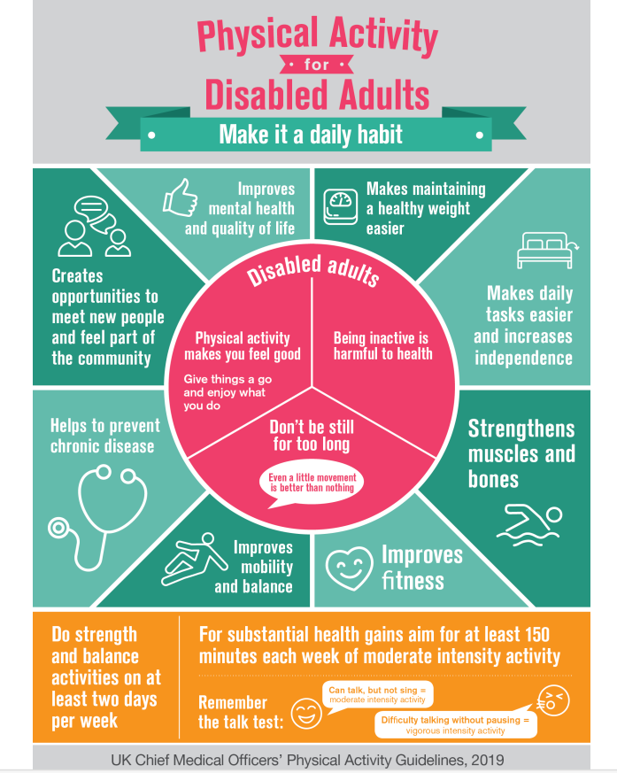
UK Chief Medical Officer Physical Activity Guidelines
Notes:
These are the UK Chief Medical Officer Guidance.
Important to note that the emphasis is strongly on the messaging to do a bit mor every day and the benefits of this without too much focus on what can often seem unattainable numbers such as 150 minutes

Slide 10
RESEARCH FINDINGS
Scottish Disability Sport
Queen Margaret University
National Survey 2025

Slide 11

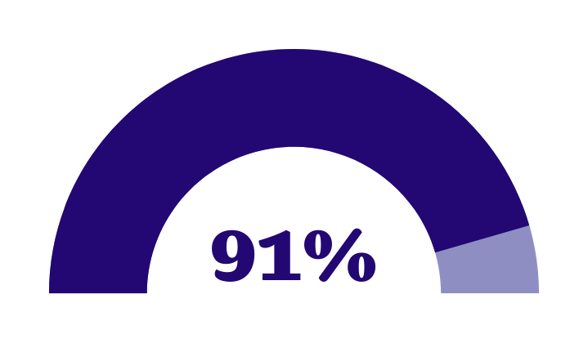


Section 2: Physical activity and sports participation
think that their disability or
health condition has an
impact on their mobility
18%
doing zero days of activity
of participants are not active every day of the week.
Notes:
91% not being active every day is possibly not that unsurprising but with almost 1 in 5 doing zero days of activity

Slide 12
Most popular sports/ activities
Notes:
These were the most popular sports and activities from the survey. There is a tendency towards individual sports with team sports not amongst the most popular. This may reflect the challenges of getting a critical mass and the higher potential for social isolation for those with a disability. The fine work of the Dundee Dragons and the Perth Eagles amongst others are doing a fine job in cultivating team sports nationally.

Slide 13
Section 2: Physical activity and sports participation ​
% Impact of Disability or Condition
Communication
52
Dexterity
68
Breathing & Stamina
68
Fatigue
56
Learning
60
Mobility
73
0
10
20
30
40
50
60
70
80
90
100
Notes:
This slide illustrates the multiple different impacts that people’s disability or health have. And how these impacts create intersecting challenges for those with a disability. Everything is generally more diffifcult.

Slide 14



There needs to be an education of our medical profession and welfare system to remove the fear of people being punished for trying to keep themselves as fit as possible to enhance their quality of life without fear of losing the benefits that they are entitled to as a result of their disability.
It feels like the last 5 years seem to have decimated opportunities for disabled
Simply put we canʼt attend events if we have no money to fund basic personal care to get out of bed let alone be taken to event and cost of carer for the whole day or evening.
It feels like accessible sports are out of the
financial means of 99.9% of disabled people
Notes:
All the quotes used in these slides are taken directly from the survey and are the opinions of the individuals involved.
Any impacts are often magnified and exacerbated for people with disabilities – Covid being a prime example.

Slide 15



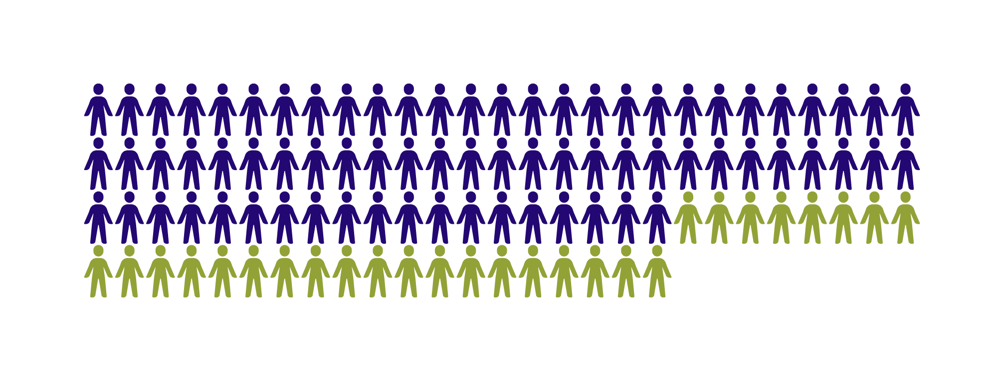
Of participants said that they
would like to do more activity
Notes:
A clear demand to do more. But what is preventing this happening?

Slide 16



I think for disabled people, physical activity is a necessity not a nice to have so as specialist activities come at a higher price, it would make sense for the government or NHS to support with the cost
Thank you for acknowledging
caring commitments. Few do.
Sometimes, I also must pay for my carer. If I could use my self-directed support to pay for it, that would help a lot.
Would be good to get cheaper access to council premises.
Notes:
We start to see some themes here of cost and inaccessible opportunities.

Slide 17
Section 3: Cost of living factors and benefits /
social security barriers
64%
64%
agree that being supported to be more active now will reduce the need to access social care in the future
41%
41%
agree that they are worried their benefits will be taken away if they are seen to be more physically active
42%
45%
42%
believe the rising cost of living has impacted their ability to be more active
20%
45%
agree that they rely on the benefits to be more active
20%
know of someone who has had their benefits reduced as a result of being considered more physically active
Notes:
More than a third of people are worried their benefits will be taken away if seen to be more physically active.
We know that there is an ongoing transition from the Personal Independence Payment delivered by the Department of Work and Pensions to Child and Adult Disability Payment and Social Security Scotland are highlighting theirs is a more compassionate and transparent process. Nonetheless, there is clearly a deep-seated fear and with good reason as 1 in 5 know of someone whose benefits have been reduced.
We also start to see the preventative approach to health and social care with almost two thirds of participants believing that the need to access social care in the future would be reduced by being supported to be active now.

Slide 18
It isn’t so much the cost of transport but availability and practical options. For example, it takes too long to get to a venue
Having very little access to sports activities has a detrimental effect on my mental and physical health
The NHS prescription has just been withdrawn in my area it took a lot of persuasion to get help in the gym for myself . I know of people who would like to be more active but are embarrassed and worried about lack of hoists to get in the swimming pool and lack of provision for anything else
Cost and access are
the biggest barriers to me.
Notes:
When funding is cut – what is amongst the first things to go?
The familiar tales of barriers and impacts come to the fore here. Confidence is proven time and time again to be a barrier and for good reason.

Slide 19
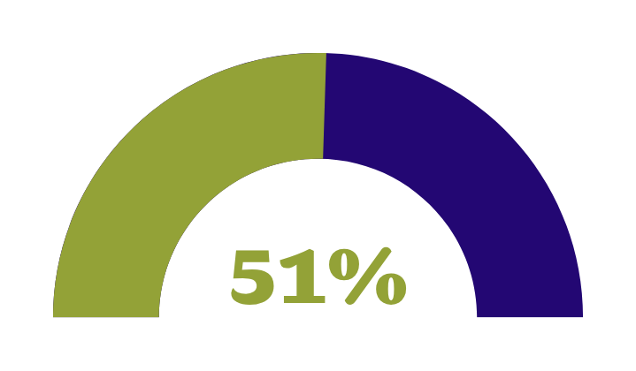

Section 4: Travel and urban vs rural
More local facilities would be good. I have to drive over 50 miles each way to take part in wheelchair sports
40
36%
30
33%
31%
Better public transport connections / faster / more frequent
Improved societal attitudes to people with disabilities or long-term health conditions
A personal assistant / ‘exercise buddy’ to drive or accompany on public transport
live outside of a city or a large town
20
10
Participants’ Top 3 items identified as making a positive difference for public transport
Notes:
Over half live outside a city or large town. This then highlights the difficulties of accessible travel.

Slide 20
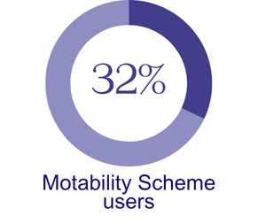

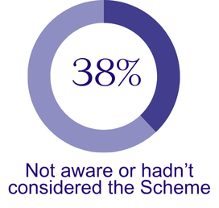
Motability

Slide 21
Can't run my home without the disability money so need it all just to live. Can't afford the scheme as a fulltime wheelchair user.
It's a life saver. Without it I would not be able to get around
Many charging facilities are not wheelchair accessible
The use of a Motability car does allow me to participate in sport and physical activity as I live in a small town and have to travel to all
of the opportunities I access.

Slide 22
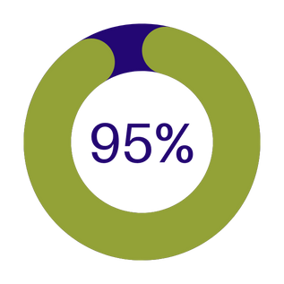
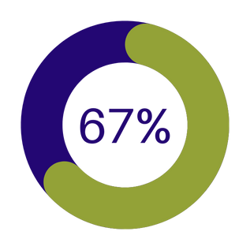
Section 5: Personal and emotional factors
and life experiences
feel that taking part in sport and physical activity has benefits for their
health and wellbeing
would find it very hard to take part in sport or physical activity without the support of
family and friends

Slide 23


92%
Believe that sport or physical activity IS for people with a disability or condition like theirs.
38%
Agree that they are not confident to take part in sport or physical activity because of factors related to their disability or condition.

Slide 24
There was little support for people with learning disabilities to maintain an active lifestyle causing health issues for the future
I'm newly disabled in later life. I had no idea how much I'd miss exercising. There are so many barriers to appropriate exercise activities
I'm socially and physically
isolated due to my disabilities
I honestly feel that care packages should consider the importance of physical activity and how this would save money in the future

Slide 25
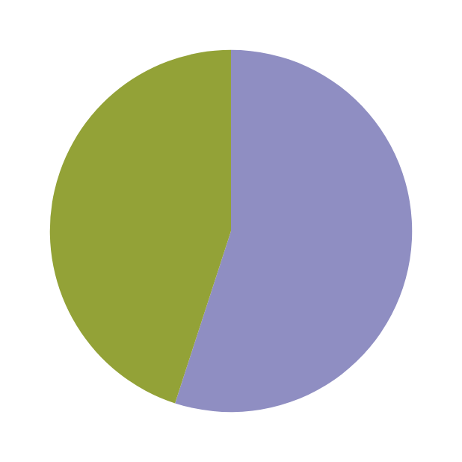
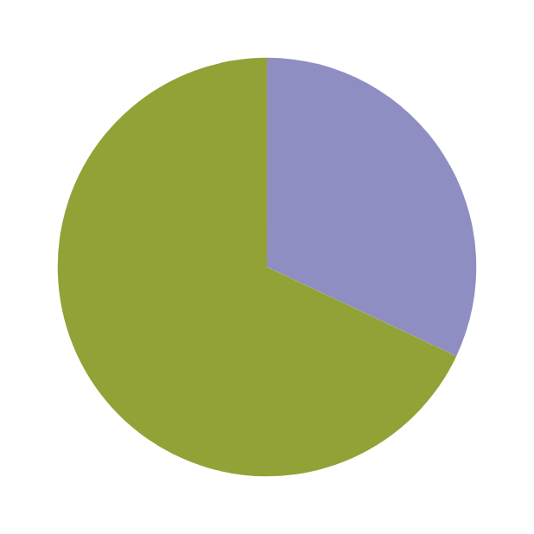
Section 6: Support with transitioning and
staying in sport or physical activity
68%
  of participants were
  not aware of the work of Scottish Disability Sport
45%
of participants have been recommended to take part in more sport and physical activity by a health or social worker

Slide 26
Section 6: Support with transitioning and
staying in sport or physical activity
I haven’t had any support
from health professionals
Yes, the cardiologist did recommend exercise, but the local council would not allow me to use self-directed support budget to pay for sport activities
In fact, they [health professionals] seem surprised that I am taking part in sport. Not that I am at a level to break a world record, but just that I am in general. There still seems to be a 1950's mentality that disabled people can't (or even shouldn't), rather than they can, should or might want to.

Slide 27
I’ve been disabled for half my life. I had no idea who you (SDS) were.
People who are on PIP, struggle to look after themselves and struggle to leave the house. [They] would benefit from physical activity if supported but fear of losing benefits is a big factor
Physical activity should be part of the NHS prescription, so the expectation is that you would participate (with support), rather than the onus being on the individual to find their own way into being active as appropriate to their disability

Slide 28
Intersectionality
The complex, cumulative way in which the effects of multiple forms of discrimination (such as racism, sexism, and classism) combine, overlap, or intersect especially in the experiences of marginalised individuals or groups.

Slide 29


Section 7: Intersectionality
MY DISABILITY OR
HEALTH CONDITION
81%
23%
MY DISPOSABLE INCOME
Personal characteristics that
participants believe negatively
impact their involvement in
physical activity and sport:
19%
MY AGE

Slide 30
Call to Action
Plan to include
Reduce inequalities for people with disabilities through inclusive strategy, policy, development and proportionate funding
Invest in systemic change to remove barriers to accessible travel, affordable and accessible facilities and inclusive spaces
Deliver an inclusive whole system approach
Every person with a disability has the right to take part in quality inclusive physical activity, physical education and sport
A health and social care system that prescribes appropriate physical activity opportunities at every stage of the individual’s pathway
A benefits system that equips individuals to be active
Provide safeguards to reassure people with disabilities that being active will not negatively impact any government financial assistance
Those in receipt of Self-Directed Support in Scotland should be able and encouraged to use their budget to engage in physical activity and sport.
Champion intersectionality through a person-centred approach
Collaborate with partners across sectors to champion intersectionality within policy, strategy and development
Ensure the needs of people with disabilities with intersecting identities are considered and met by co-production with those with lived experience

Slide 31
Call to Action – Easy Read
Fair and Equal Support for Disabled People
Make sure all important decisions made by organisations and funding plans include disabled people fairly.
Put money into long-term changes that remove barriers like difficult or expensive travel; Inaccessible buildings or facilities; lack of inclusive spaces
Inclusive Support Across the Whole System
Everyone working in sport, physical education, or activity should learn how to include disabled people properly through good training.
Health and care services should suggest suitable physical activity at every stage of a person’s care journey.
A Benefits System That Helps People Be Active
Make sure disabled people know being active won’t cause them to lose their financial assistance they receive from the government
In Scotland, people using Self-Directed Support should be allowed to spend their budget on sport and physical activity.
Support the Whole Person
Work together with disabled people to design better policies that understand people have many parts to their identity (like race, gender, sexuality).
Always think about and meet the needs of disabled people who face extra barriers due to who they are.

Slide 32
🔗 Plan to include
Key Message:
We must reduce inequalities by ensuring that strategies, policies, and funding are inclusive and fair for people with disabilities
Why this Matters:
Disabled people often face exclusion and unfair access in society and in physical activity and sport
What Needs to Change:
Make strategies and policies fully inclusive of disabled people from the start.
Inclusive planning and development leads to equality of opportunities.
Invest in system-wide change to remove barriers, including.
Ensure funding is proportionate to the need (i.e. for true equality, more investment is needed for those with a disability)
Difficult or expensive travel
Inaccessible facilities
Non-inclusive spaces
Notes:
Use Disability Equality Scotland stats

Slide 33
🔗 Deliver an inclusive whole-system approach
Key Message:
Why this Matters:
Disabled people face inconsistent experiences across education, sport, and healthcare.
What Needs to Change:
Ensure everyone delivering sport or physical activity has quality disability inclusion training.
Everyone involved in sport, physical activity, and health must work together to make inclusion part of the whole system — from training to care pathways.
A joined-up approach helps create long-term, meaningful inclusion.
Build a health and care system that:
Prescribes appropriate activity at every stage of care
Sees physical activity as a core part of wellbeing

Slide 34
🔗 A benefits system that equips individuals to be active
Key Message:
The government must give clear guidance and strong processes that reassure disabled people that being active will not affect their financial support.
Why this Matters:
Disabled people should not fear losing benefits for being seen as active.
What Needs to Change:
Update benefit policies to reflect the value of physical activity.
Improve clarity during assessments and applications.
Allow people to use benefits confidently to pay for sport and physical activity.
Current benefit rules and systems can discourage participation in physical activity.

Slide 35
🔗 Champion intersectionality through a person-centred approach
Key Message:
Why this Matters:
What Needs to Change:
Inclusion must recognise that people have many identities. We must shape policies and spaces that reflect the full diversity of disabled people.
One-size-fits-all approaches will often miss key needs.
Disabled people may face additional barriers due to race, gender, age, sexuality, religion or other identities.
Make sure policies and services actively consider the needs of people with multiple, intersecting identities.
Collaborate and co-produce with disabled people from all backgrounds when shaping strategy and policy.

Slide 36
What’s next?
Cross-sector action needed across education, healthcare, sport, transport and social care
Scottish Elections 2026
Next SDS Strategic Plan
Campaign and Messaging
Ongoing collaboration with key partners

